Slide 1
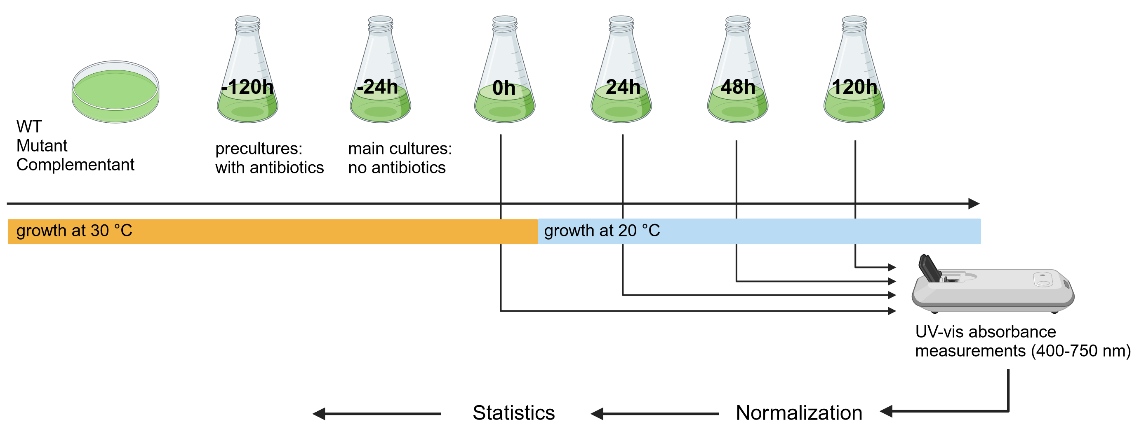
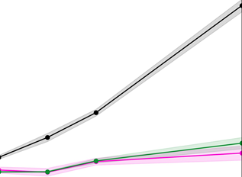
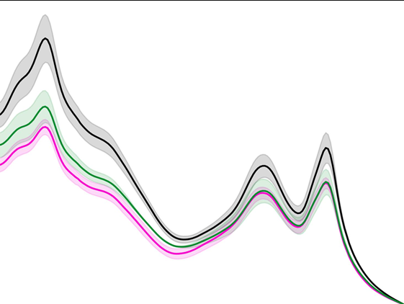
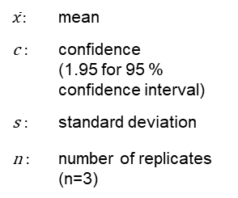



Experimental workflow
Growth curves
$$\left[\overline{x}−\frac{cs}{\sqrt{n}},\overline{x}+\frac{cs}{\sqrt{n}}\right]$$
$$\frac{Abs(x nm)−Abs(750nm)}{Abs\left(750nm\right)}$$
Absorption spectra
$\overline{x}$: | mean
c : | confidence (1.95 for 95 % confidence interval)
s : | standard deviation
n : | number of replicates (n=3)
For each spectrum:
Abs(x nm) : | absorbance at each measurement point x
Abs(750 nm) : | absorbance at 750 nm
Pigment ratios
$$\frac{Abs(phycobillin) }{Abs\left(chlorophyll a\right)}$$
Data analysis workflow
Notes:
Figure 1: Workflow for the investigation of photosynthetic pigment content in Synechocystis wild-type, Δrbp1 mutant and complementant cells under cold shock.
The experimental part of the workflow consisted in in growing cell cultures and measuring UV-vis spectra (400-750 nm) before and after induction of cold shock (transition from 30 °C to 20 °C). The resulting data was normalized to cell density (absorbance at 750 nm) and statistical analysis was performed using a T-test (n=3, p=0.05) . Finally, the resulting data was visualized as growth curves, absorption spectra and pigment ratios (phycobilin over chlorophyll a). This enabled a physiological investigation of the role of Rbp1 in photosynthetic pigment content under cold shock.

